Slide 1


Mental Health Tracker
Nishchal Naithani- 22BCE8449
Gaurang Dosar - 22BCE7438 Sarthak Vats - 22BCE7413
Kingsley Nadar - 22BCE7684
Chinnola Akash Rao - 22BCE8371
instructor’s Name - Prof. Deepasikha Mishra
REVIEW-1

Slide 2
Index
Agenda Topics:
Introduction
Motivation and Relevance
Objective
Problem Statement
Proposed Approach
Literature review
Market Analysis and Revenue Projection

Slide 3

IntroDuction
In today's fast-paced world, emotional well-being and mental health have become critical areas of focus. SoulLink, short for Emotional Synchronization, is a groundbreaking innovation designed to revolutionize how individuals interact with their emotions and track behavioral patterns. This compact, AI-powered device combines sentiment analysis, meditation guidance, and behavioral tracking into a single, seamless experience.
At the heart of SoulLink lies its innovative design, featuring a dynamic robotic eye animation displayed on a 0.96" OLED screen. This engaging visual interface reacts to users' emotional states and inputs, creating a deeply interactive and personalized experience. By leveraging state-of-the-art machine learning and wearable sensors, SoulLink delivers real-time feedback, empowering users to better understand and manage their emotions.

Slide 4

IntroDuction
SoulLink, an innovative device, offers interactive journaling and guided meditation to enhance emotional intelligence and mental resilience. Its affordable design ensures accessible emotional well-being support.
SoulLink is a companion on the path to self-awareness and improved mental health, inspiring mindfulness and emotional balance.

Slide 5

Motivation and relevance
SoulLink addresses the rise in stress, anxiety, and mental health issues with an integrated platform that combines emotional tracking, sentiment analysis, guided meditation, and behavior monitoring.
It caters to a broad demographic, helping them better understand emotions, enhance mindfulness, and track progress

Slide 6
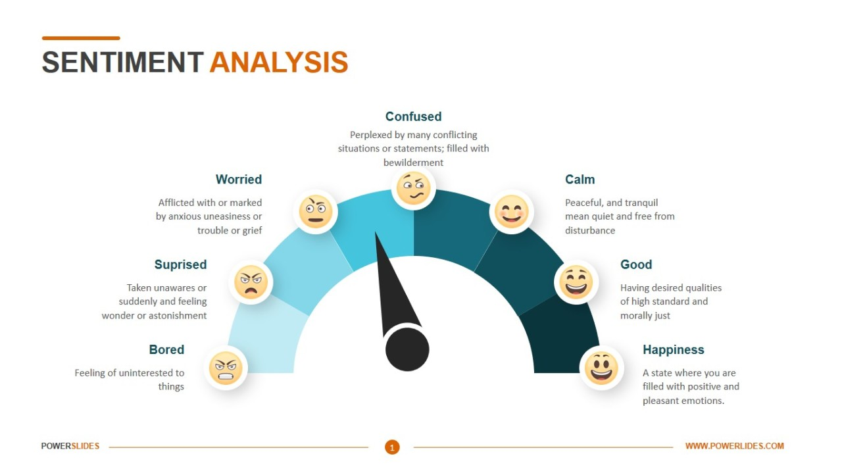
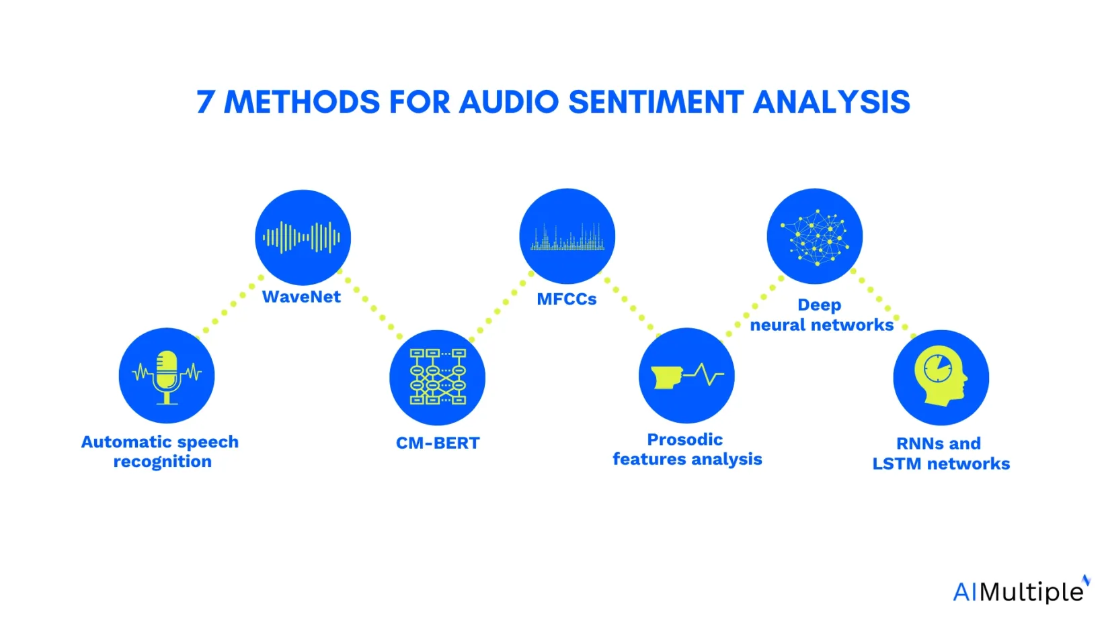
Objectives
The key objectives of SoulLink are:
Real-Time Sentiment Analysis: Analyze user emotions through speech-to-text conversion, machine learning (LSTM), and facial expression analysis.
Dynamic Emotional Display: Showcase detected emotions through robot eye animations on a 0.96" OLED screen.
Behavioral Tracking: Monitor physical activity, heart rate, and breathing patterns using wearable sensors to provide actionable insights into emotional and behavioral states.
Interactive Journaling: Enhance journaling practices by analyzing audio and video inputs to predict and document emotional states.
Guided Meditation: Provide audio-guided meditation and feedback based on real-time physiological data (heart rate, breathing patterns).
Accessibility & Affordability: Create a cost-effective solution for users to monitor their mental health conveniently at home

Slide 7
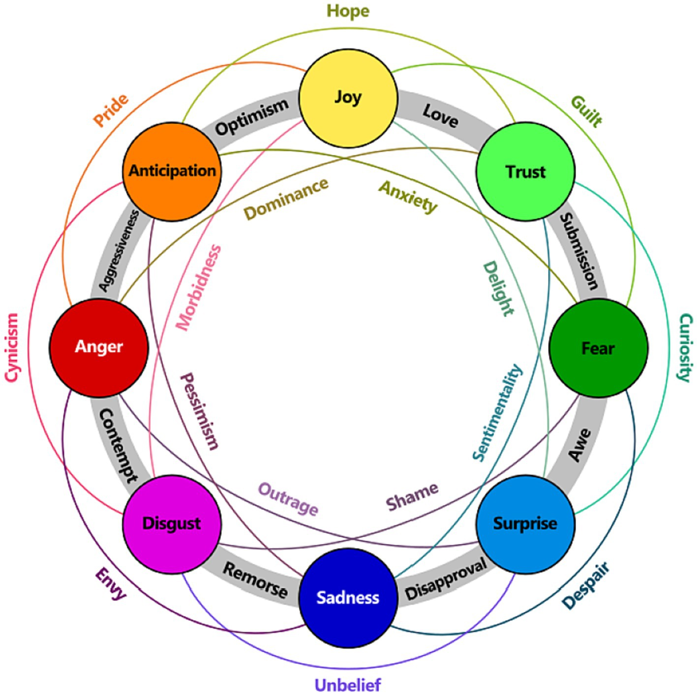
Problem Statement
Despite growing awareness of mental health, existing solutions are:
Cost-Prohibitive: High prices make them inaccessible to a large population, especially in developing nations like India.
Fragmented: Users need separate tools for sentiment analysis, behavioral tracking, and meditation guidance.
Lack Interactivity: Current solutions often fail to provide real-time, engaging, and personalized feedback.
SoulLink addresses these issues by providing a single, integrated, and affordable device that brings emotional intelligence, behavioral analysis, and meditation tools together in an engaging and user-friendly manner.

Slide 8
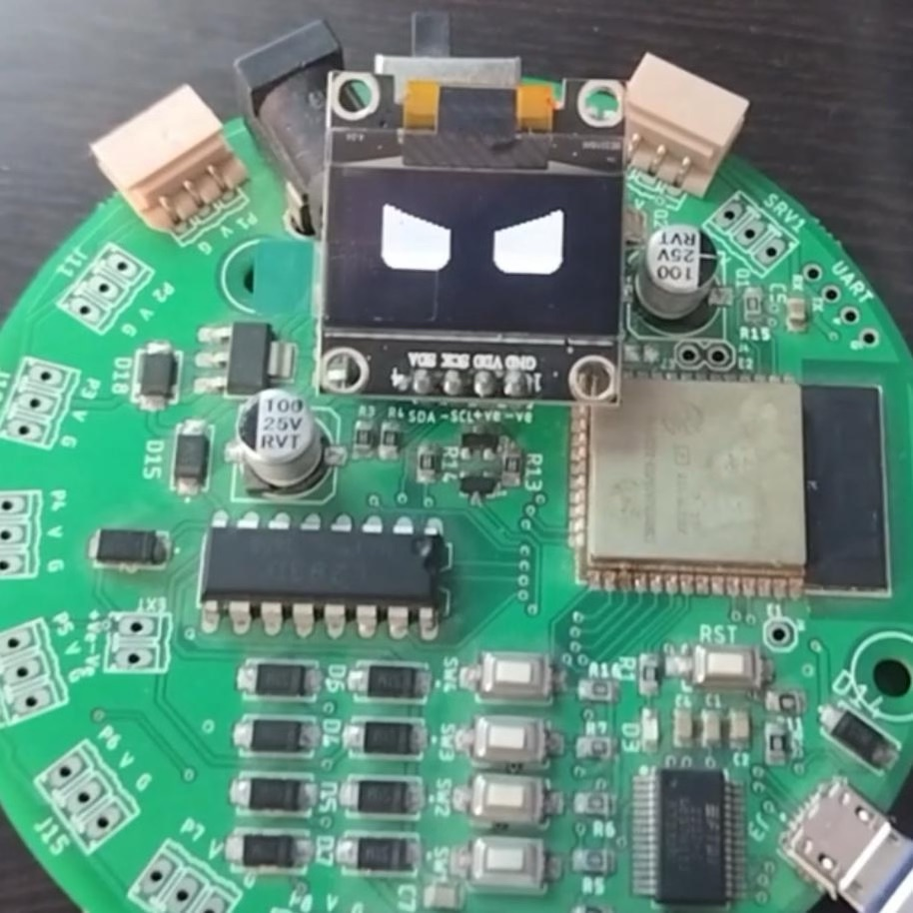
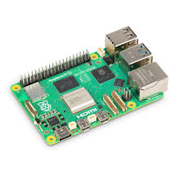

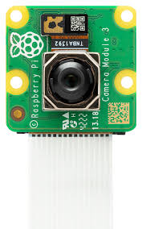
Proposed Approach
SoulLink combines hardware and software innovations to deliver an integrated mental health solution:
1. Hardware Integration
Core Components:
Raspberry Pi 4 Model B
CAP10 Pratham board
Pulse sensor
Accelerometer/gyroscope
Microphone
0.96" OLED display
Functionality: Collects physiological data such as heart rate, physical activity, and breathing patterns for real-time analysis.

Slide 9
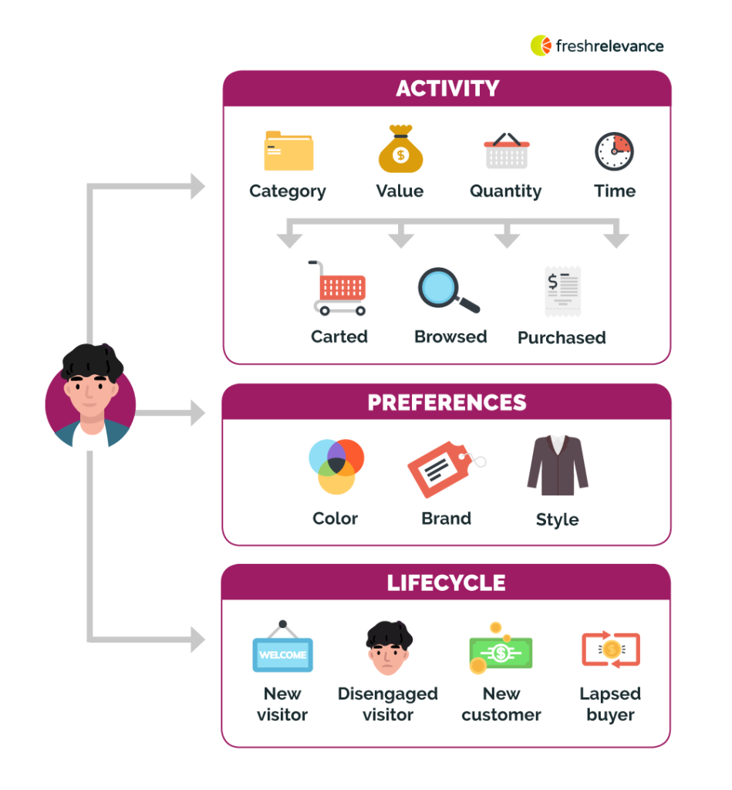
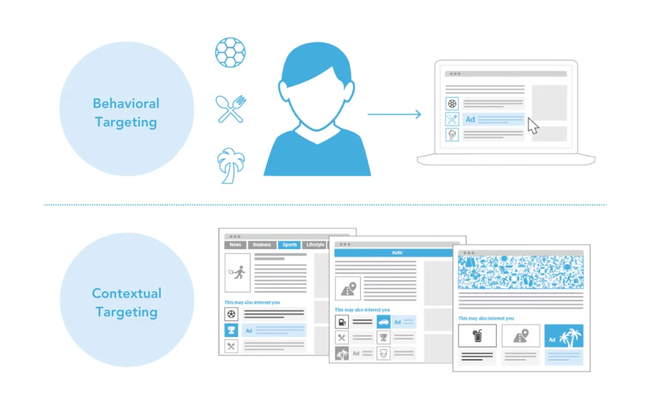
Proposed Approach
2. Software Development
Sentiment Analysis:
Speech-to-text conversion using WhisperX.
Emotion classification via LSTM models and facial expression detection.
Displays detected emotions dynamically using OLED eye animations.
Behavioral Tracking:
Heart rate, activity level, and breathing pattern monitoring via sensors.
Behavioral insights and emotional analysis visualized in real-time.
Interactive Journaling:
Records audio and video inputs to predict user states using tone and facial analysis.
Summarizes key patterns through NLP techniques for personalized insights.
Guided Meditation:
Text-to-speech audio guides for meditation sessions.
Provides feedback on heart rate and breathing synchronization for improved mindfulness.
User Interface: Intuitive design for easy access to progress reports, journaling tools, and device settings.

Slide 10
Literature Review
Article Title | Focus Area | Key Contributions | Key Findings
Deep Learning Techniques in Sentiment Analysis | Sentiment Analysis | Explores LSTMs and hybrid models for text sentiment classification | LSTMs and CNN+LSTM models excel at handling sequential data for sentiment tasks
The Role of Biofeedback in Stress Management | Stress Management | Focuses on biofeedback interventions for heart rate and breathing control | Enhances stress reduction, emotional regulation, and resilience
Interactive Emotional Interfaces | Human-Machine Interaction | Examines emotional AI for user engagement and ethical considerations | Emotional AI increases user satisfaction and dynamic adaptability
Wearable Devices for Activity Tracking | Mental Health Monitoring | Studies the use of wearables for tracking physical activity and health patterns | Promotes self-awareness, timely intervention, and improved health in mental illness
Mental Health of Adolescents | Adolescent Mental Health | Highlights prevalence, causes, and interventions for mental health issues | Early interventions reduce mental health burden in adolescents
Machine Learning for Cognitive Behavioral Analysis | Behavioral AI | Reviews ML models for stress, emotion, and lie detection | ML enhances real-time, accurate behavioral predictions
Behavior Analysis Using ML in Health Care | Health Risk Prediction | Explores ML in detecting lifestyle-related risk factors | ML-driven behavior modification reduces risks and enhances health outcomes

Slide 11
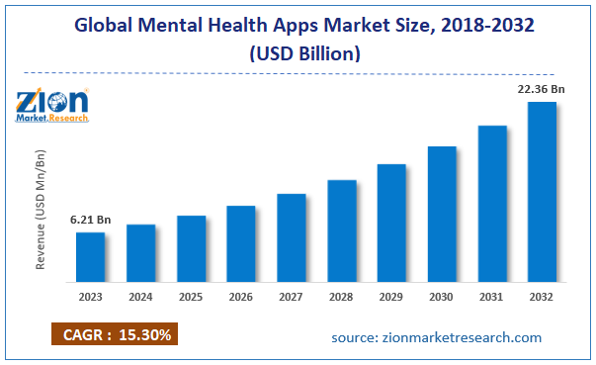
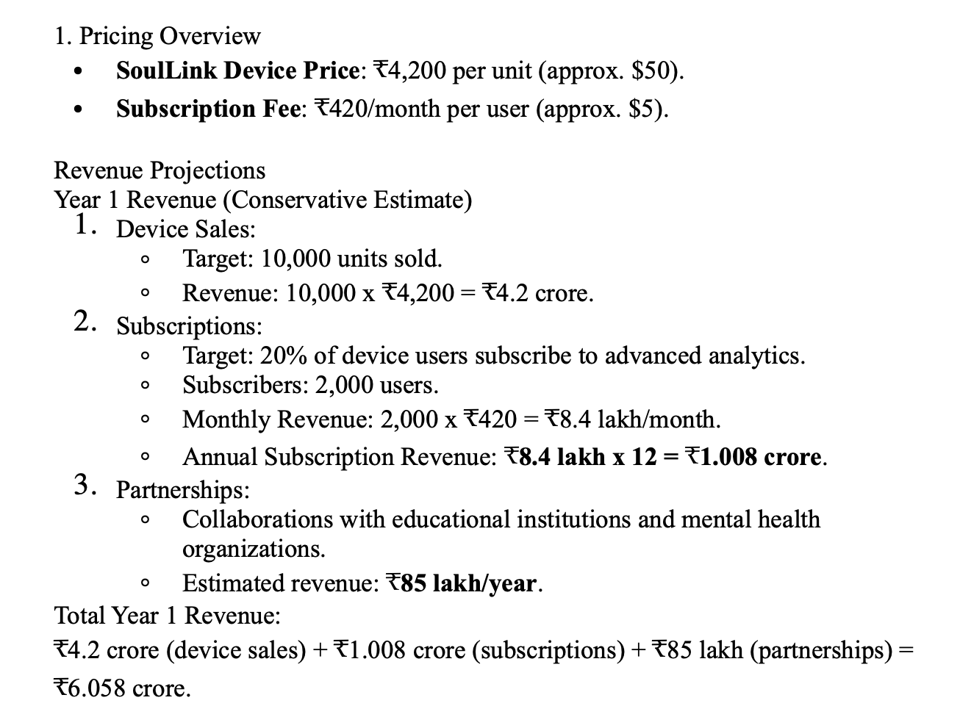
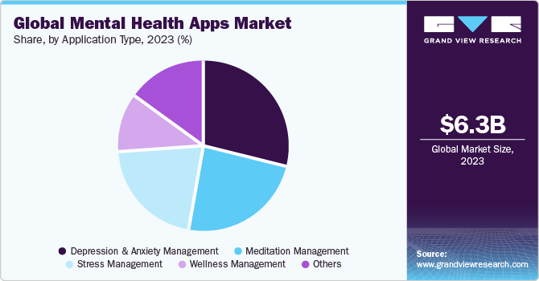
Market analysis

Slide 12
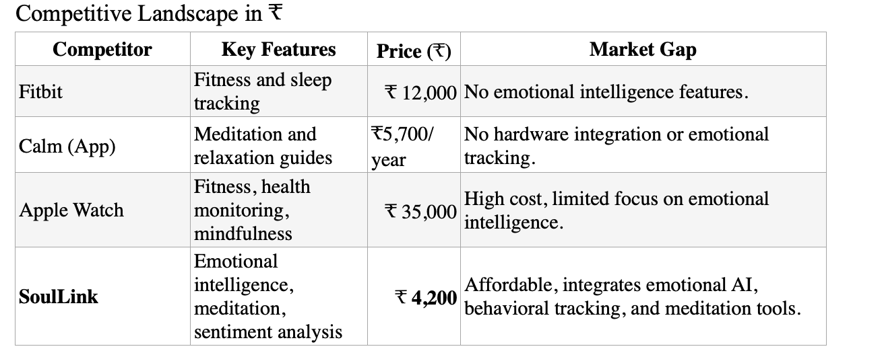
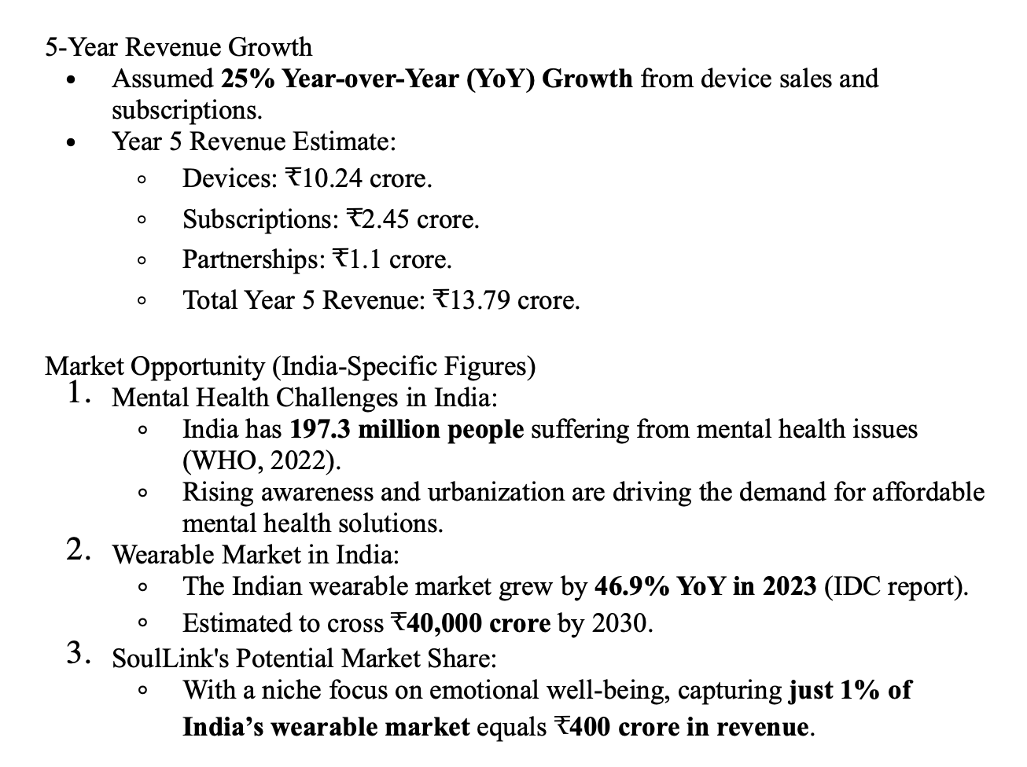
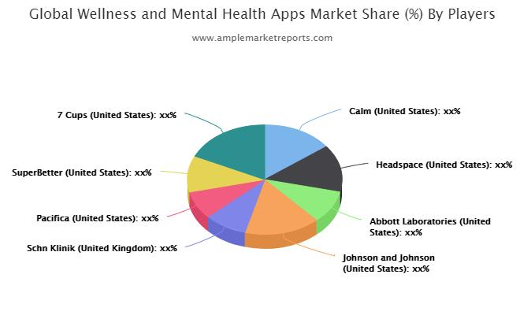
Market analysis

Slide 13

Market analysis

Slide 14
Workflow of the Project
SoulLink has the following components that we will work on:
Real-time Sentimental-Behavioral Analysis- involving facial, Voice, text, vitals.
Working-1: The robot will monitor you for at least an hour to understand your mood and initiate a conversation on its own to better comprehend your mental state and enhance your mental well-being by evoking positive emotions.
Working-2: You will interact with the robot, answering questions or simply recounting your day’s experiences.
Journaling- Acts as your interactive diary and we aim to build a place where you can record your thoughts and it can act as a throwback to the mood/ state of mind you had on that day , it can remember this and monitor your overall well-being through it.
Interactive Nature of the robot, acting as a friend of yours with which you can share your ups and downs, making this all possible by providing Animated-Emoji facial response through an LCD Display and visual response your voice played through a speaker. It will take the real-time sentiments analyzed by our model in order to respond appropriately to the user.
Monitoring in order to facilitate the Guided Meditation and ways to improve your mood and mental status.
Report Generation and Gamifying the interface in order to encourage users to maintain a healthy interaction with the device so as to keep track of your mental health as well as improve it over time using pre-tested medicated ways after understanding your mental status and helping maintain a good mental status in your life.
Cross-platform integration , communicating it with a custom-made app and Google or ChatGPT API integration in order to assist you with your day-to-day activities , engaging more with the user and hence able to track your mental status.

Slide 15
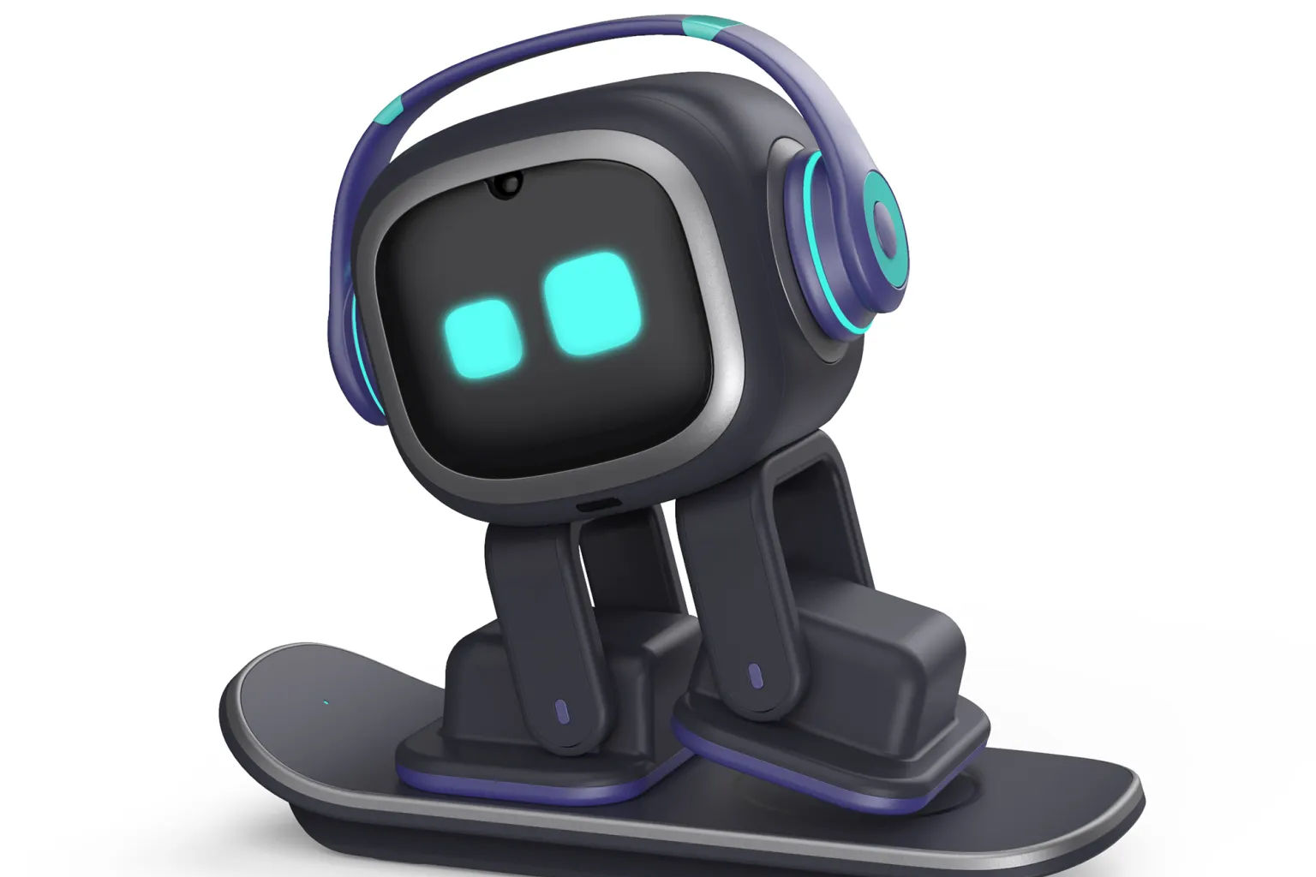
Product Comparison
EMO PET
Emo Pet
Limited Emotional Connection: lack real emotions and can feel artificial
Reduced Focus: Designed with playful or interactive features, they might reduce focus rather than improve it.
Luxury Item: High-quality AI desk pets can be expensive, making them a luxury rather than a necessity.
SoulLink
Soul Link desk pet adapts to their owner's habits and preferences, improving their interactions over time.
Uses Real - Time Face and Voice emotional detection
Tracks behavior and Documents emotions over time, remembers sensitive topics and trigger words.
Strictly Therapy focused robot.

Slide 16
Feature Based Comparison
Existing apps in the market are : (Talkspace, Calm, Moodfit, Happify, Mindshift)
Feature | SoulLink | Existing Mental Health Apps
Sentiment Analysis | Real-time emotion detection using speech-to-text, LSTM, and facial analysis | Manual mood tracking based on user-input logs
Emotional Display | Displays detected emotions through robot eye animations on OLED screen | No physical representation, feedback is text-based or graphical
Behavioral Tracking | AI based models will detect the mood and give appropriate responses | Limited tracking, and an actual therapist will provide you the services
Interactive Journaling | Predicts emotions from audio/video analysis and documents them automatically | Traditional text-based journaling with manual input
Guided Meditation | Adjusts meditation sessions in real-time based on live physiological data | Pre-recorded meditation sessions with no live adaptation
Accessibility & Cost | One-time purchase or low-cost solution for home mental health monitoring | Subscription-based services with recurring costs
Physical Interaction | Tangible, interactive desk bot that users can engage with | Fully digital app experience, lacks physical presence

Slide 17
App based Comparison of existing products
1. Real-Time Sentiment Analysis vs. App-Based Mood Tracking
Existing Apps: Moodfit and Happify use self-reported mood tracking, which relies on users actively logging emotions.
SoulLink: Uses speech-to-text analysis, LSTM machine learning models, and facial expression tracking for real-time, passive sentiment analysis, making it more accurate and dynamic than manual mood logging.
2. Dynamic Emotional Display vs. No Physical Representation
Existing Apps: No physical representation of emotions—feedback is mainly via text or charts.
SoulLink: Displays detected emotions through robot eye animations on an OLED screen, creating an interactive and visually engaging experience.
4. Interactive Journaling vs. Traditional Digital Journals
Existing Apps: Apps like Moodfit offer text-based journaling but lack emotion prediction from multimedia inputs.
SoulLink: Enhances journaling with audio and video analysis, automatically detecting emotional states and providing insightful documentation without requiring users to manually describe their feelings.
5. Guided Meditation Based on Real-Time Data vs. Pre-Set Meditation Routines
Existing Apps: Calm and Mindshift offer meditation but use pre-recorded sessions with no real-time adaptation.
SoulLink: Provides customized, real-time meditation guidance by adjusting sessions based on live heart rate and breathing patterns, making it a truly personalized experience.

Slide 18
Research paper analysis
1. Facial Sentiment Analysis Using AI Techniques: State-of-the-Art, Taxonomies, and Challenges (Published : 2022)
This paper delves into advancements in machine and deep learning algorithms for facial sentiment analysis.
It presents a taxonomy of existing strategies and reviews various models designed for facial expression recognition based on static images.
The authors discuss challenges such as handling occlusions, varying lighting conditions, and diverse facial orientations.
They emphasize the importance of robust datasets and the need for models that can generalize across different populations and environments.
Authors : Keyur Patel; Dev Mehta; Chinmay Mistry; Rajesh Gupta; Sudeep Tanwar; Neeraj Kumar
https://ieeexplore.ieee.org/document/9091188

Slide 19
Research paper analysis
2. Sentiment Analysis on Voice Data Using Deep Learning(Published 2022)
This study focuses on classifying human emotions through voice data.
The researchers employed deep learning techniques to categorize emotions such as neutral, calm, happy, sad, angry, nervous, and disgusted.
The paper highlights the significance of audio features like pitch, tone, and rhythm in determining sentiment.
The authors also discuss the challenges of distinguishing subtle emotional variations and the potential of combining audio analysis with other modalities for improved accuracy.
Authors : Deepa Yogish1 , Asha N 2 , Yogish H K3 , Abhishek K L4
http://ijnrd.org/papers/IJNRD2204094.pdf

Slide 20
Research paper analysis
3.Robust Image Sentiment Analysis Using Progressively Trained and Domain Transferred Deep Networks(Published: 2015)
This paper explores sentiment identification through facial expressions using deep convolutional neural networks (CNNs).
The study emphasizes the role of nonverbal communication in sentiment analysis and discusses applications in security, healthcare, and human-machine interfaces.
The authors highlight the challenges of capturing dynamic facial expressions and the importance of temporal information in accurately identifying emotions. They also address the need for large-scale annotated datasets to train deep learning models effectively.
Authors: Quanzeng You , Jiebo Luo
https://www.researchgate.net/publication/282072489_Robust_Image_Sentiment_Analysis_Using_Progressively_Trained_and_Domain_Transferred_Deep_Networks

Slide 21
Research paper analysis
4. A Simple Attention-Based Mechanism for Bimodal Emotion Classification (2024)
This paper presents novel bimodal deep learning architectures enhanced with attention mechanisms, trained and tested on text and speech data for emotion classification.
The study demonstrates that combining textual and audio features leads to better performance compared to models trained on a single modality. The authors provide a detailed analysis of different architectures and their effectiveness in capturing the nuances of human emotions.
They also discuss the role of attention mechanisms in focusing on the most relevant features for emotion detection.
Authors: Mazen Elabd, Sardar Jaf
https://arxiv.org/abs/2407.00134

Slide 22
Other References
https://pmc.ncbi.nlm.nih.gov/articles/PMC4845759/#abstract1
https://www.who.int/news-room/fact-sheets/detail/adolescent-mental-health
https://pmc.ncbi.nlm.nih.gov/articles/PMC4225959/#abstract1
https://pmc.ncbi.nlm.nih.gov/articles/PMC4409431/#sec1
https://braininformatics.springeropen.com/articles/10.1186/s40708-023-00196-6#Abs1
https://ieeexplore.ieee.org/document/10141829
https://pmc.ncbi.nlm.nih.gov/articles/PMC9919280/

Slide 23
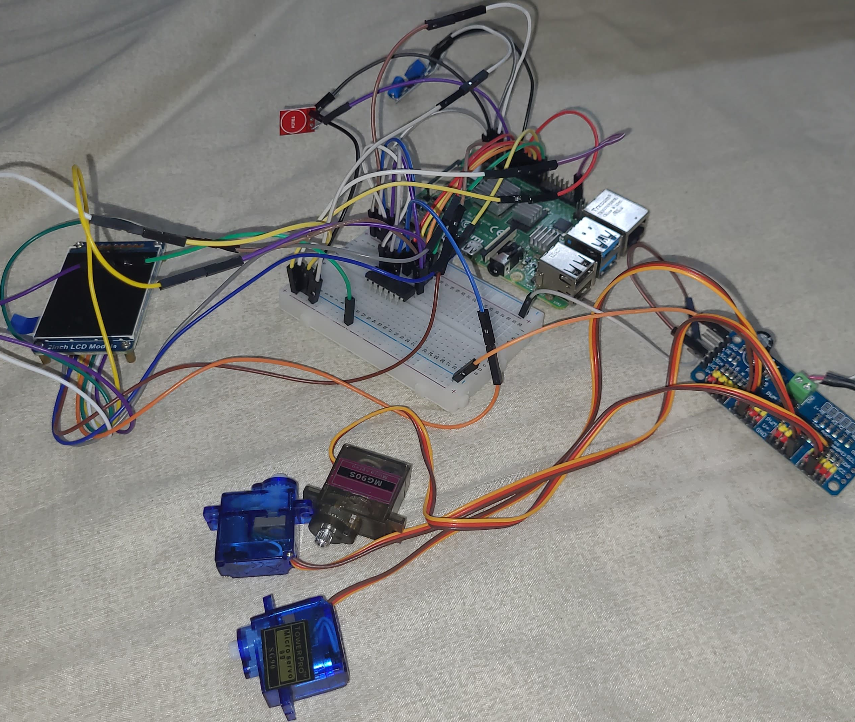
Our Product
Consists of the following components:
Raspberry Pi 4
3 Servo Motors
2inch LCD Display
MAX9814 Microphone
Touch sensor
Vibration sensor
DAC- DC to AC converter

Slide 24
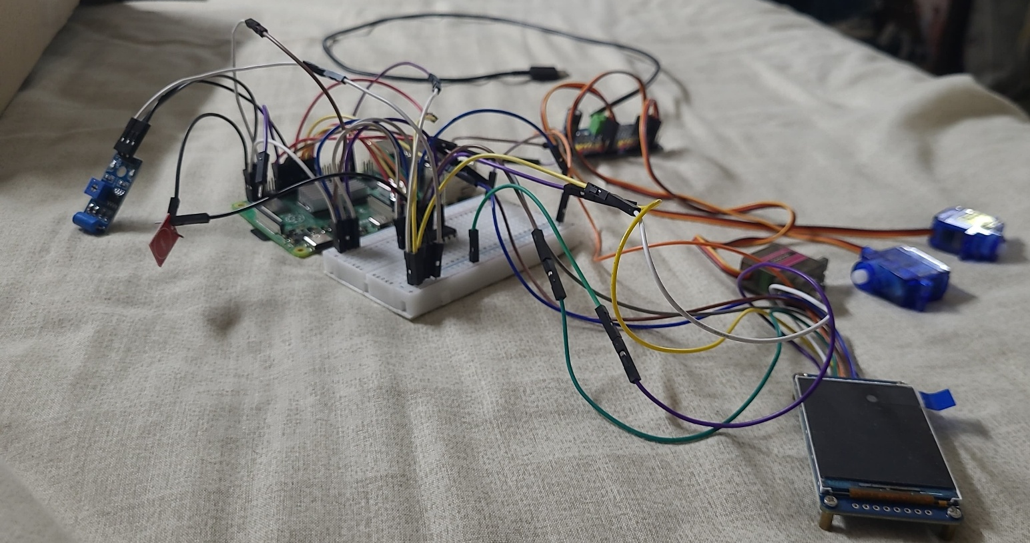
Work Flow
Here’s how our analysis takes place
Raw Data
Users Speech
Users Facial Expressions
Processed Data
Model Analysis
Robots Response
Sentimental Analysis
Report Generation
Hardware Inputs

Slide 25
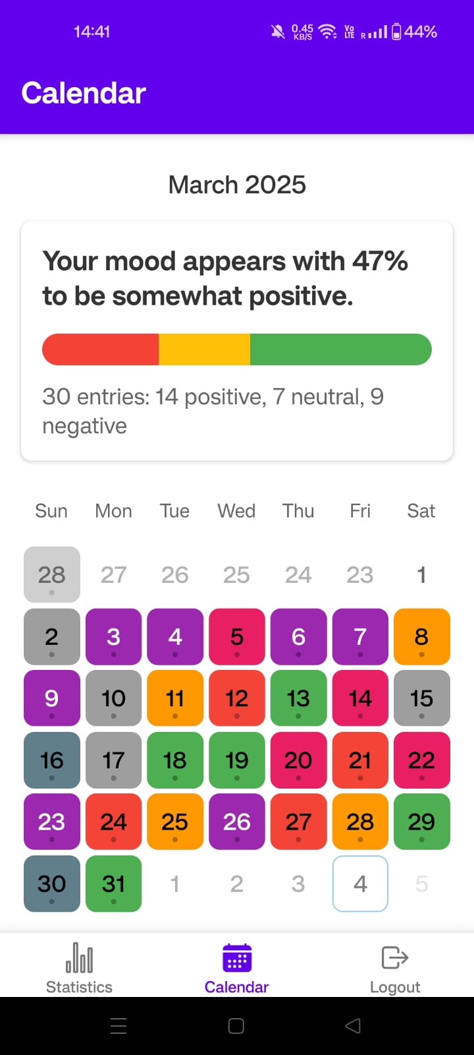
Work Flow
Here’s how our Transfer takes place
Processed Data
Model Analysis
APP
Visualization
Report Generation
Hardware Inputs
SERVER

Slide 26
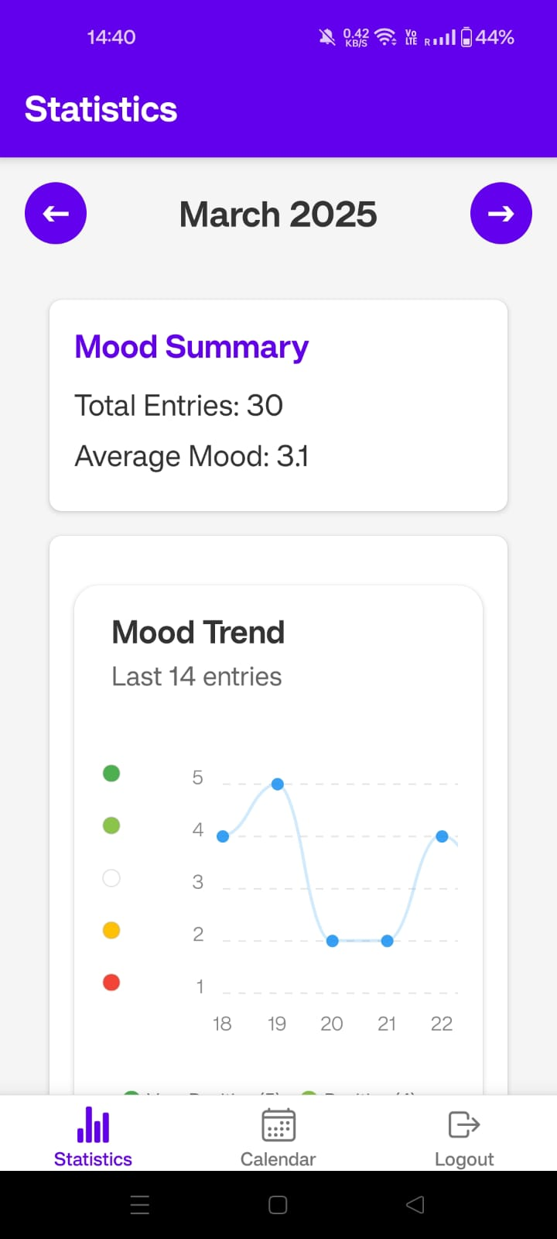
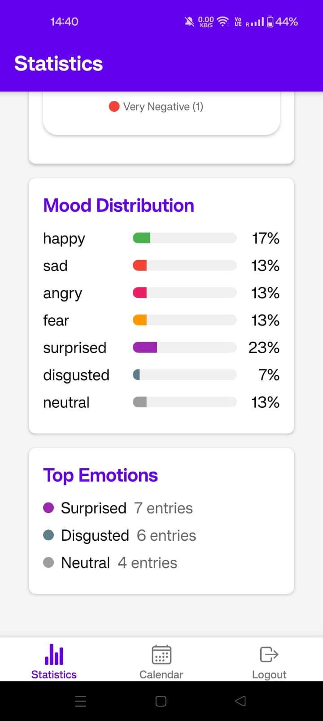
Our app
Keeps track of the following information:
Facial Expressions
Voice Analysis
Top Emotions
Mood Distributions
Monthly Callender Analysis
Mood Summary

Slide 27





WORK FOR REVIEW -3
Custom Application and Back-end server - Nishchal
Real Time Sentimental - Behavioral Analysis: Facial, text, ChatBot - Akash
Voice and research analysis - Sarthak
Real Time Facial Responses and Software integration - Kingsley
Hardware Integration – Gaurang
Nishchal
Akash
Kingsley
Gaurang
Sarthak

Slide 28


